Slide 1
Benefits of an Industrialized KI Approach to Application Quality
PATRICE GIRAUD

Slide 2
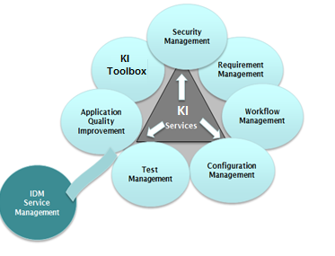
Content: Introduction to Atos B&PS KI initiative
High Business Objectives linked to profitability, cost reduction, risk reduction and quality improvement of software delivery.
KI ready for KI Execution.
Standard B&PS tooling hosted in a central industrialized platform for all practices allowing distributed delivery.
Offering standard configurations and reporting but allowing required customizations.

Slide 3
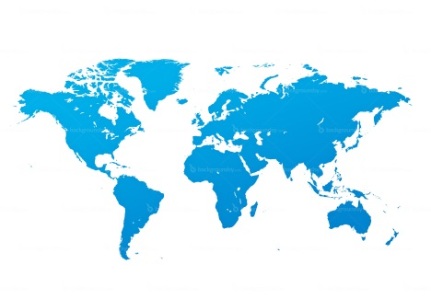
Vision: To execute proper KI standards in all contracts by deploying B&PS KI tools
Project Management
Contract Execution
Plan
Document management/ collaboration/ translation
Planning & Time
Management
Estimates
& Measures
CEP online
SharePoint
PARMA / ESS
PARMA/ Lean
Resource
Management
Risk
Management
ROMA
PARMA / CINDY
Software Engineering
IT Service
Management
Test
Management
ServiceNow/ SDM 12
HPALM
Requirement management
Change
management
Configuration
management
Code Quality Analysis & Measurement
HPALM
RTC/ClearQuest
ClearCase
CAST
KI Processes supported by standard web-based applications, deployed in a SaaS mode by our KI-Tools

Slide 4
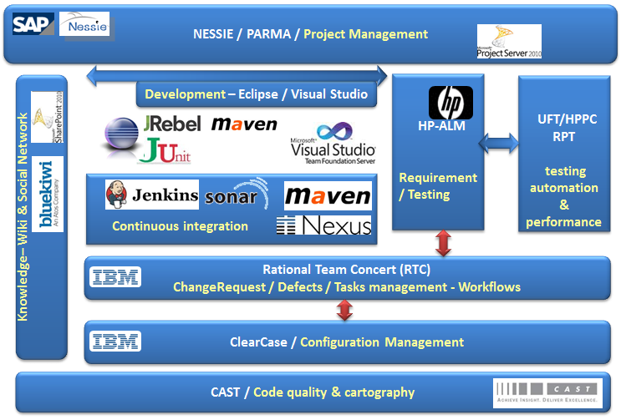
Atos B&PS KI constitutes a platform INTEGRATING best of breed customized market packages
Requirements Management
Division and structured analysis of demand
Manufacturing impact on following; quality, adequacy, tests, configuration delivery
Demand and Delivery management
Code enhancement change management
Base of configuration on the whole initiatives
Delivery and configuration Control
Acceptance Management
Workflow and structured tests realization in delivery with requirement management
Management of defects
Software Production Line
Tooling models
Development riders on international operability
Dedicated application development workbenches
Application Quality Management
Application architecture Cartography
Systematic Code Analysis and actions plans to improve
Application performances
Application robustness
Application changeability
Application security
DevOps
Continuous feed back monitoring
application virtualization for continuous testing
Continuous deployment

Slide 5
KI Tools RACI Matrix per Application
CAST | ServiceNow/WorkSmart | HPALM | JAVA/DotNet
INFRA* KI Team is mainly involved in co-ordination activity hence no RACI Matrix is required. | MS-Tech | JAZZ Solutions | ClearCase

Slide 6
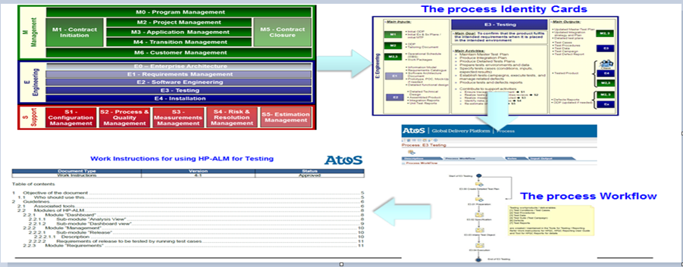
… that instantiates and automates Atos B&PS KI Operational end2end Processes Repository
KI link: https://sp2013.myatos.net/si/gdp/Pages/HomePage.aspx

Slide 7
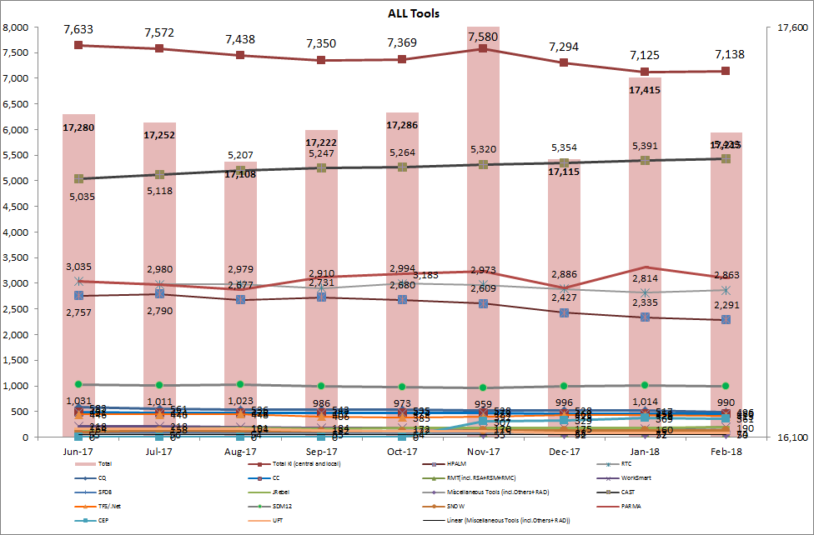
Our B&PS KI internal usage is extended allover Atos B&PS GBU’s and GDC’s
17000+ users for KI core solutions
7000+ Users for Core Solutions
2200+ users for HPALM
3900+ users for Rational
5400+ CAST users
900+ SDM12 users

Slide 8
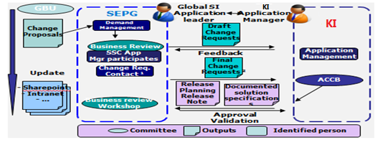
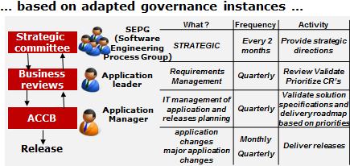
Atos B&PS KI Evolution Governance follows a formalized process
… taking in account arbitration between the different GBU …
… resulting in published KI evolution releases plans
Release | CR List | Defect List | Deployment Production
AtosINT V9.08 | CR-0005 (SSCT2) | DEF-000200 | 30-Sept-2010
AtosINT V9.09 |  | DEF-000209 DEF-000210 | 24-Sept-2010
AtosINT V9.10 | CR-000253(SCCT1) |  | 21-Oct-2010
AtosINT V09.11 | CR-0005 (SCCT2) /CR0003(SCCT2) |  | 16-Nov-2010
AtosINT V10.0 | CR-000251(SCCT1) /CR0003(SCCT2) CR-000255(SCCt1) |  | 22-Dec-2010
AtosALMA V35.08 | CR-000243(SSCT1) CR-000247 (SCCT1) CR-000248 (SCCT1) CR-000247(SSCT1) |  | 08-Nov-2010
AtosALMA V35.09 |  | DEF-000212 DEF-000180 DEF-000127 | 09-Dec-2010
AtosALMA V36.0 |  | DEF-000211 DEF-000213 | 09-Dec-2010
Full traceability from requirements to releases delivered and defects detected

Slide 9
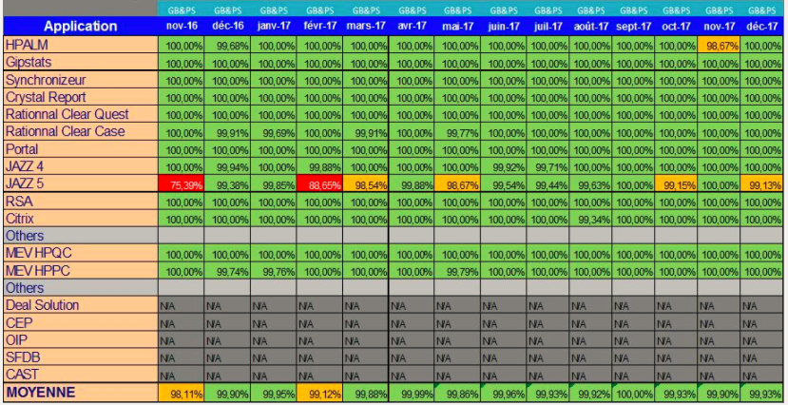
Industrialized internal application hosting guaranties KI solutions availability SLA (>99,7% on 22/24 7/7)

Slide 10
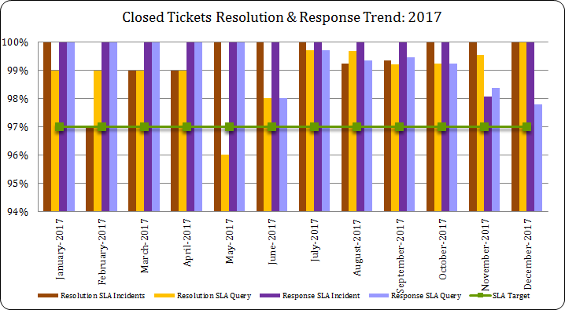
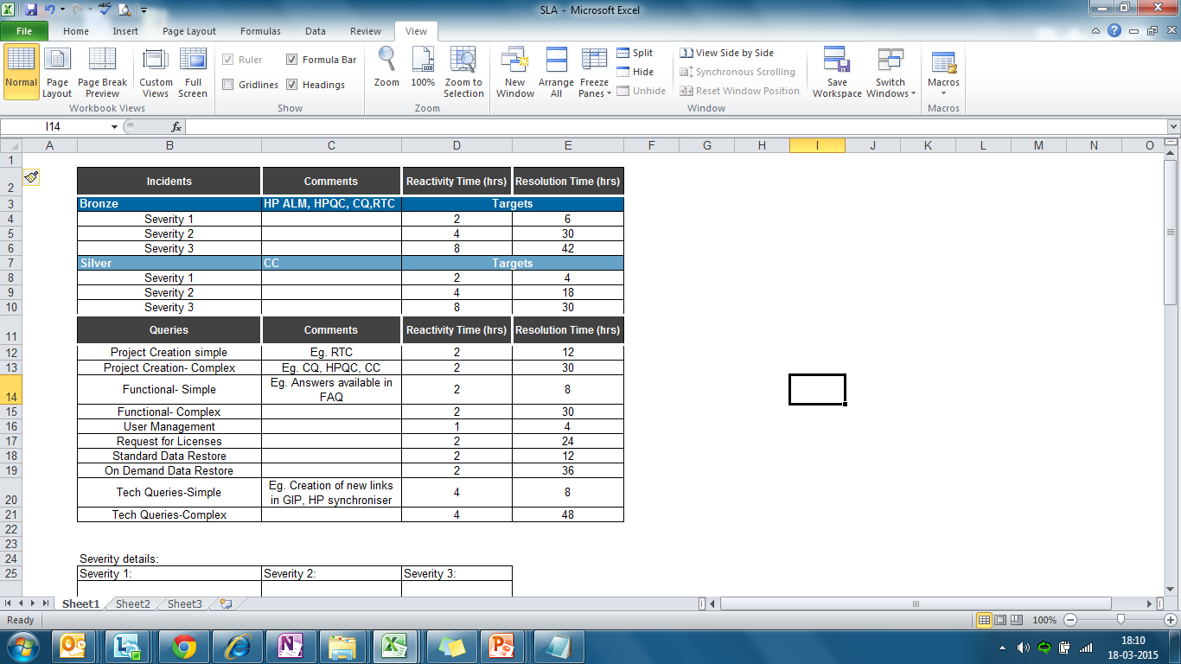
As well as industrialized off-shored Atos B&PS KI delivers support to Global Practices according to committed SLA
Severity 1:
An entire application is down
No users worldwide can access an application
At least 50% of the user base can not access an application
An entire country or Atos major location (>80 SI users) can not access an application
Severity 2:
An entire project can not access an application
A country, Atos location or an entire project (with more than 10 users) is experiencing response time/performance issues
Severity 3:
Single isolated users can not access an application or are experiencing response time/performance issues (ie not all users for a project or a location are impacted. The issue is limited to certain random users)
Project creation from 1 to 2,5 days
Users management in less than 4 hours
Functional support
Technical support
Standard restore services

Slide 11
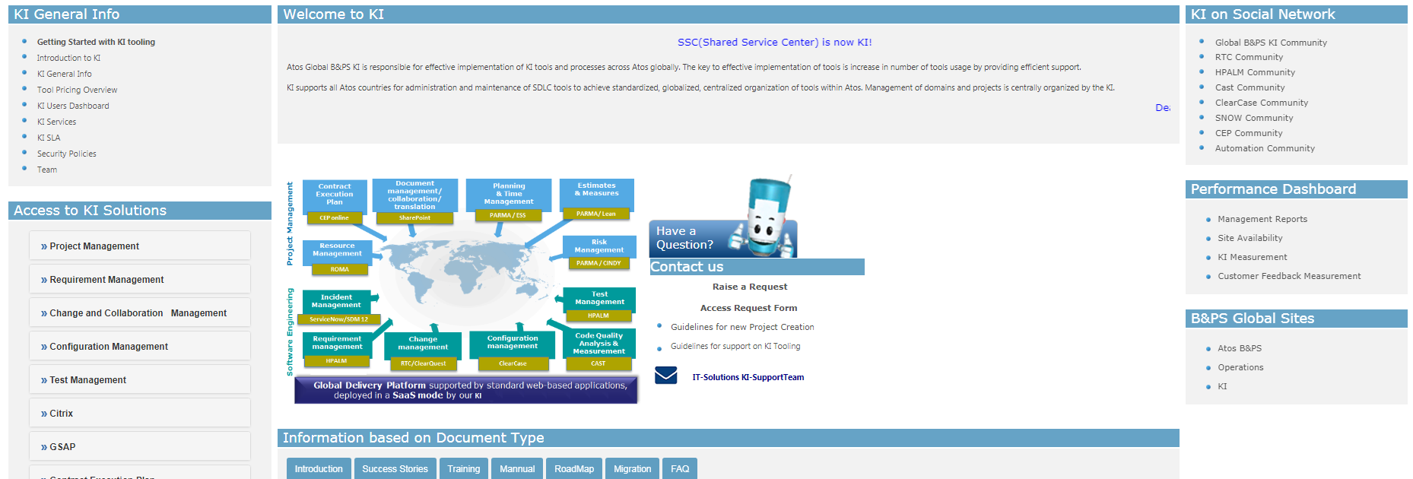
How to proceed to subscribe to KI solutions for a project
https://sp2013.myatos.net/si/operations/tooling/Pages/home.aspx

Slide 12
Appendix
KI Physical Infrastructure
Project Level Continuous Integration
Our Way Of Working
Process Model
Service Level Agreement
Backup And Retention Policy

Slide 13
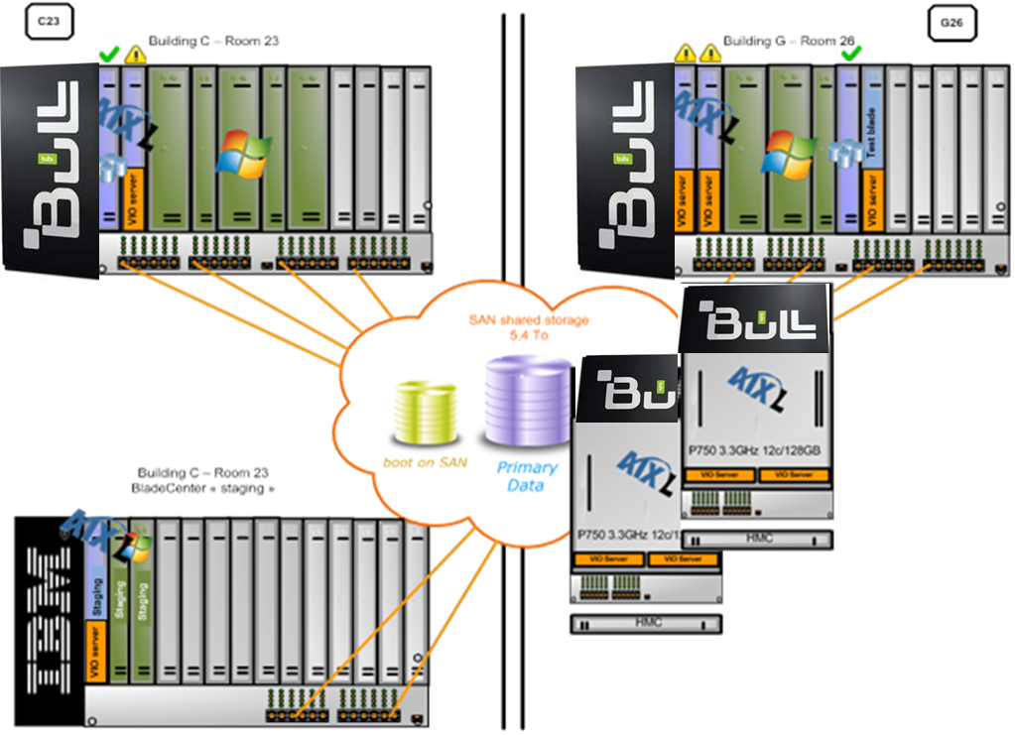
Physical infrastructure supporting KI v.2

Slide 14
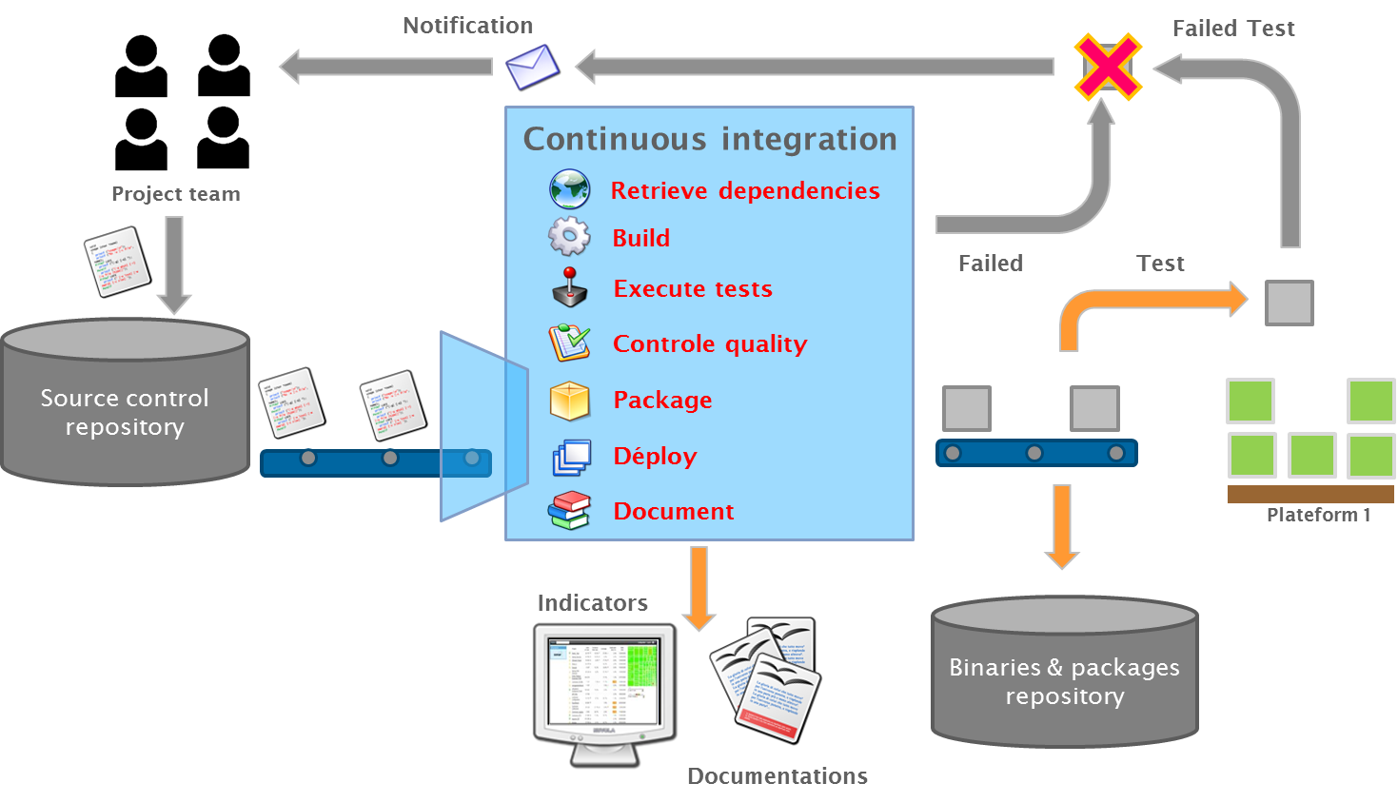
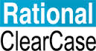



Java continuous integrations
Project level implementation

Slide 15
Java continuous integration
Referenced Tooling
Continuous integration is built on
RTC as the central management tool
Apache Maven to describe libraries dependencies and operate builds
Jenkins for job orchestration
KI SCM Clear Case for software configuration management
Nexus to store binaries
JUnit to automate unit testing
Sonar for program code coding-rule checking and unit testing coverage
CAST for application quality improvement

Slide 16
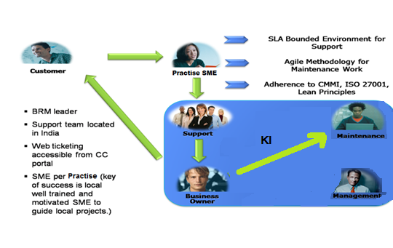
Our Way of Working
Atos Global B&PS KI team is responsible for effective implementation of KI tools and processes across Atos globally. The key to effective implementation of tools is increase in number of tools usage by providing efficient support.
KI supports all Atos countries for administration and maintenance of SDLC tools to achieve standardized, globalized, centralized organization of tools within Atos. Management of domains and projects is centrally organized by the KI.
KI Landscape:
KI mainly deals with Application Support & Maintenance activities comply with contract guidelines.
Application Support is following inbound Service Level Agreements whose base foundation is Quality, Resolution Time, and Communication with End users.
Application Maintenance mainly focuses on mitigation of KI in-house developed products based on customer Inputs.

Slide 17
KI Tools – Support Scope
Incidents User is facing a technical issue with KI tools that prevent him from working | Queries An user can request for: User creation Project creation Functional Queries Technical Queries Data Management Issues License requirements CAST Analysis | Problem Resolve issues that result in recurring incidents or potential incidents
Service Requests Service request allows users to request and receive standard services. | Knowledge Knowledge base created in SDM in the form of CAKT for easy reference of solutions provided to repetitive/new issues

Slide 18
Process Model
KI Tools Process Model Includes:
Project Creation
User Addition
Project creation approach:
Demo of Tool
Hands-on in Sandbox
Plan your Project
Provide data to KI
KI will configure the Project
Train your team
We provide support

Slide 19
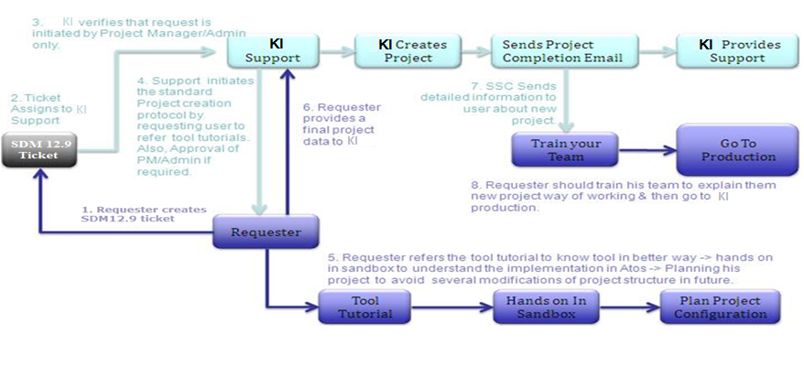
Project Creation Module

Slide 20
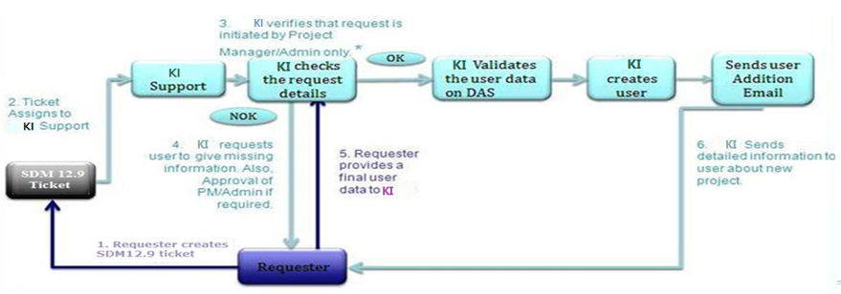
User Creation Module
For Third Party Users creation, project administrator needs to raise a request to their GBU HR Service Center

Slide 21
Ticketing Tool for KI-Support
SDM/MSP is to be selected as the tool for KI Support, as
SDM 12.9 provides stronger features for SLA Management compared to WorkSmart
KIWI reports provide a comprehensive analysis of tickets
It is easy to transfer tickets to Atos MS SDM 12.9 instance (for issues related to central platform)
License charges are not levied for SDM 12.9
For ServiceNow, Support tickets are raised in ServiceNow

Slide 22
Logging Tickets in SDM 12.9 for KI-Support
End user or Project Delivery Team will log tickets via KI Portal > click on Raise a Request (MSP-My Service Portal).
End User will log a ticket in SDM 12.9 for KI-Support using MSP
Select the request type “I have an Issue” on MSP portal.
Enter KI tool name or punch in tag as “KI” in search item and hit enter.
Select the appropriate tool for which you have to create an SDM ticket.
Choose a ”Kind of Ticket” for your request example: User Management etc..
Update short summary
Update detailed description of the issue with the Impact of the issue
Update Nessie Contract ID
Update Project Name
Update Practice Name
Update Project Domain
Upload Attachments (Access Request Form, Error Snapshot, etc.) as per user requirement.
Click on Submit button
The ticket will be logged under the Organization – Atos.ZZ.GIT.Support
Reporting of Service levels will be extracted from KIWI Reporting Tool

Slide 23
Escalation Matrix for KI-Support
Following Escalation Matrix is applicable for KI-Support with a valid Ticket registered in ATF SDM 12.9
Escalation Level | Escalation Contact | Trigger Condition
Level 1 | Rahul Dhar | No progress on Issue Resolution / no Response for 1 business days
Level 2 | Anup Pereira | No Response from Escalation level 1, for 2 business days
Level 3 | Patrice Giraud | No Response from Escalation Level 2, for 4 business days

Slide 24
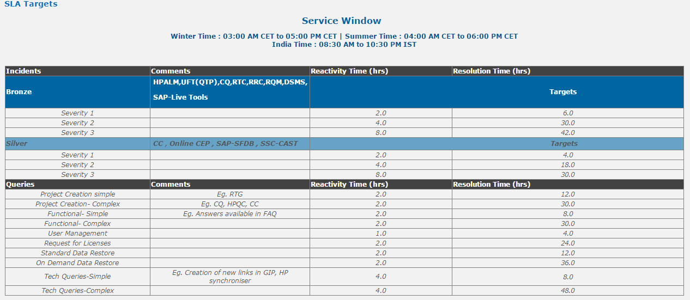
Service Level Agreement

Slide 25
How SLA Works ?
Example 1: incident severity 2 on ClearQuest is logged at 04:00 am on Monday
The clocks starts at 04:00am that same day.
Teams have 4 hours to acknowledge that tickets, i.e. until 8:00 am.
Resolution must be done in 30 working hours, which translates into 2 full days
Therefore the ticket must be resolved before Tuesday 19:00.
Example 2: incident severity 2 on ClearQuest is logged at 20:00 pm on Monday
The clocks starts at 04:00am on Tuesday
Teams have 4 hours to acknowledge that tickets, i.e. until 8:00 am.
Resolution must be done in 30 working hours, which translates into 2 full days Therefore the ticket must be resolved before Tuesday 19:00.

Slide 26
Severity details
Severity 1: An entire application is down No users worldwide can access an application At least 50% of the user base can not access an application An entire country or Atos major location (>80 B&PS users) can not access an application | Severity 2: An entire project can not access an application A country, Atos location or an entire project (with more than 10 users) is experiencing response time/performance issues | Severity 3: Single isolated users can not access an application or are experiencing response time/performance issues (i.e. not all users for a project or a location are impacted. The issue is limited to certain random users)

Slide 27
Backup & Retention Policy
Daily Backup:
Daily Backup is kept for 8 weeks. It is scheduled from Sunday night to Friday night.
e.g. If you need backup of 11th March on 13th May 2017. You will not get back of 11th March on 13th May.
Backup of 11th March is kept till 6th May (8 weeks for daily backup) as per policy.
Weekly Backup:
Weekly Backup is kept for 8 weeks. It is scheduled on Saturday night.
e.g. If you need weekly backup of 11th March 2017on 12th May 2017. You will not get back of 11th March 2017 on 12th May 2017.
Weekly backup of 11th March (week ending on 13th March) is kept till 6th May 2017(8 weeks for weekly backup) as per backup policy. Instead of weekly backup you will get monthly backup of March.
Monthly backup:
Monthly backup is kept for 53 weeks (Approx. 1 year).It is scheduled on last weekend backup of the month.
e.g. If you need monthly backup of September 2016 it will be kept till September 2017.

Slide 28
Thanks For more information please contact: patrice.giraud@atos.net

